Slide 1
Angular
Anil K

Slide 2
Unit Testing
Unit testing is a process of testing the individual component, whether it is working correctly or not.
We use “Jasmine” and “Karma” for the unit testing.
Jasmine: Used to create test cases.
Protractor: Used to execute the test cases in single browser.
Karma: Used to execute the test cases in multiple browsers.

Slide 3
c:\angular\myapp\src\app\app.component.ts
import { Component } from "@angular/core";
@Component({
selector: "app",
templateUrl: "./app.component.html"
})
export class AppComponent {
username: string = '';
password: string = '';
msg: string = '';
CheckLogin() {
if (this.username == "admin" && this.password == "manager") {
this.msg = "Successful login";
} else {
this.msg = "Invalid login";
}
}
}

Slide 4
c:\angular\myapp\src\app\app.component.html
<div>
<form>
<h1>Login</h1>
Username: <input type="text" [(ngModel.)]="username" name="username"><br>
Password: <input type="password" [(ngModel.)]="password" name="password"><br>
<input type="submit" value="Login" (click)="CheckLogin()"><br> {{msg}
</form>
</div>
c:\angular\myapp\src\app\app.component.css
/*your own css*/

Slide 5
c:\angular\myapp\src\app\app.component.spec.ts
import { TestBed, async } from '@angular/core/testing';
import { AppComponent } from './app.component';
import { FormsModule } from "@angular/forms";
describe('AppComponent', () => {
beforeEach(async(() => {
TestBed.configureTestingModule({
declarations: [AppComponent],
imports: [FormsModule]
}).compileComponents();
}));
it("Login - Success", async(() => {
const fixture = TestBed.createComponent(AppComponent);
const app = fixture.debugElement.componentInstance;
app.username = "admin";
app.password = "manager";
app.CheckLogin();
expect(app.msg).toBe("Successful login");
}));

Slide 6
c:\angular\myapp\src\app\app.component.spec.ts
it("Login - Fail", async(() => {
const fixture = TestBed.createComponent(AppComponent);
const app = fixture.debugElement.componentInstance;
app.username = "abc";
app.password = "def";
app.CheckLogin();
expect(app.msg).toBe("invalid login");
}));
});

Slide 7
c:\angular\myapp\src\app\app.module.ts
import { BrowserModule } from '@angular/platform-browser';
import { NgModule } from '@angular/core';
import { FormsModule } from '@angular/forms';
import { AppComponent } from './app.component';
@NgModule({
declarations: [ AppComponent ],
imports: [ BrowserModule, FormsModule ],
providers: [ ],
bootstrap: [AppComponent]
})
export class AppModule {
}

Slide 8
c:\angular\myapp\src\main.ts
import { enableProdMode } from '@angular/core';
import { platformBrowserDynamic } from '@angular/platform-browser-dynamic;
import { AppModule } from './app/app.module';
import { environment } from './environments/environment';
if (environment.production) {
enableProdMode();
}
platformBrowserDynamic().bootstrapModule(AppModule)
.catch((err: any) => console.log(err));

Slide 9
c:\angular\myapp\src\index.html
<!doctype html>
<html lang="en">
<head>
<meta charset="utf-8">
<title>Myapp</title>
<base href="/">
<meta name="viewport" content="width=device-width, initial-scale=1">
<link rel="icon" type="image/x-icon" href="favicon.ico">
</head>
<body>
<app-root></app-root>
</body>
</html>

Slide 10
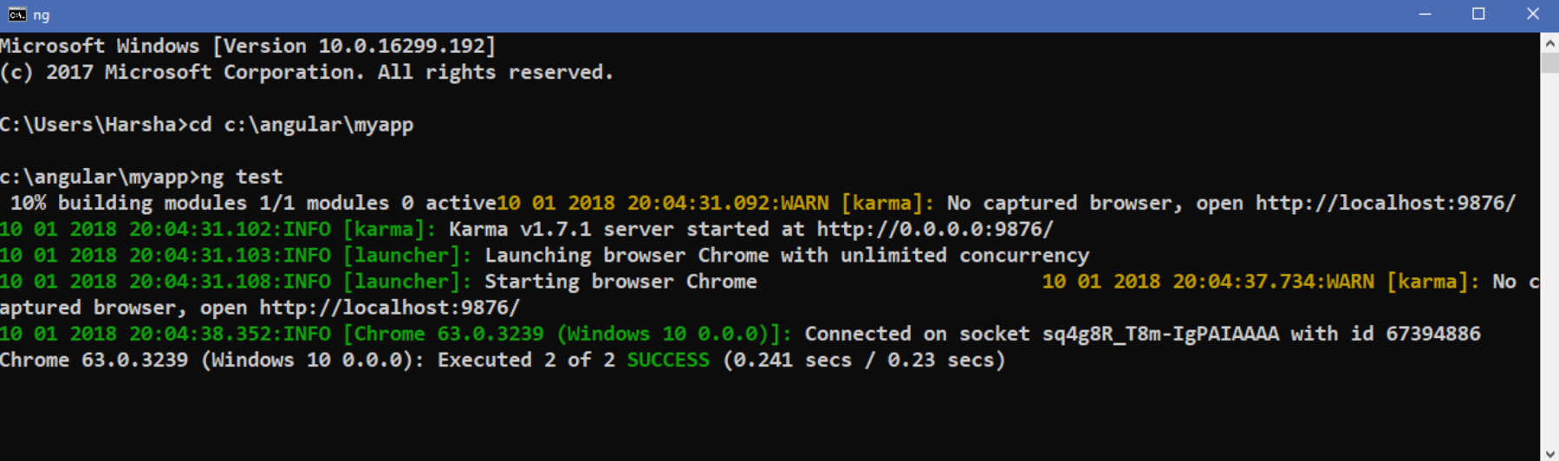
Executing the application:
Open Command Prompt and enter the following commands:
cd c:\angular\myapp
ng test

Slide 11
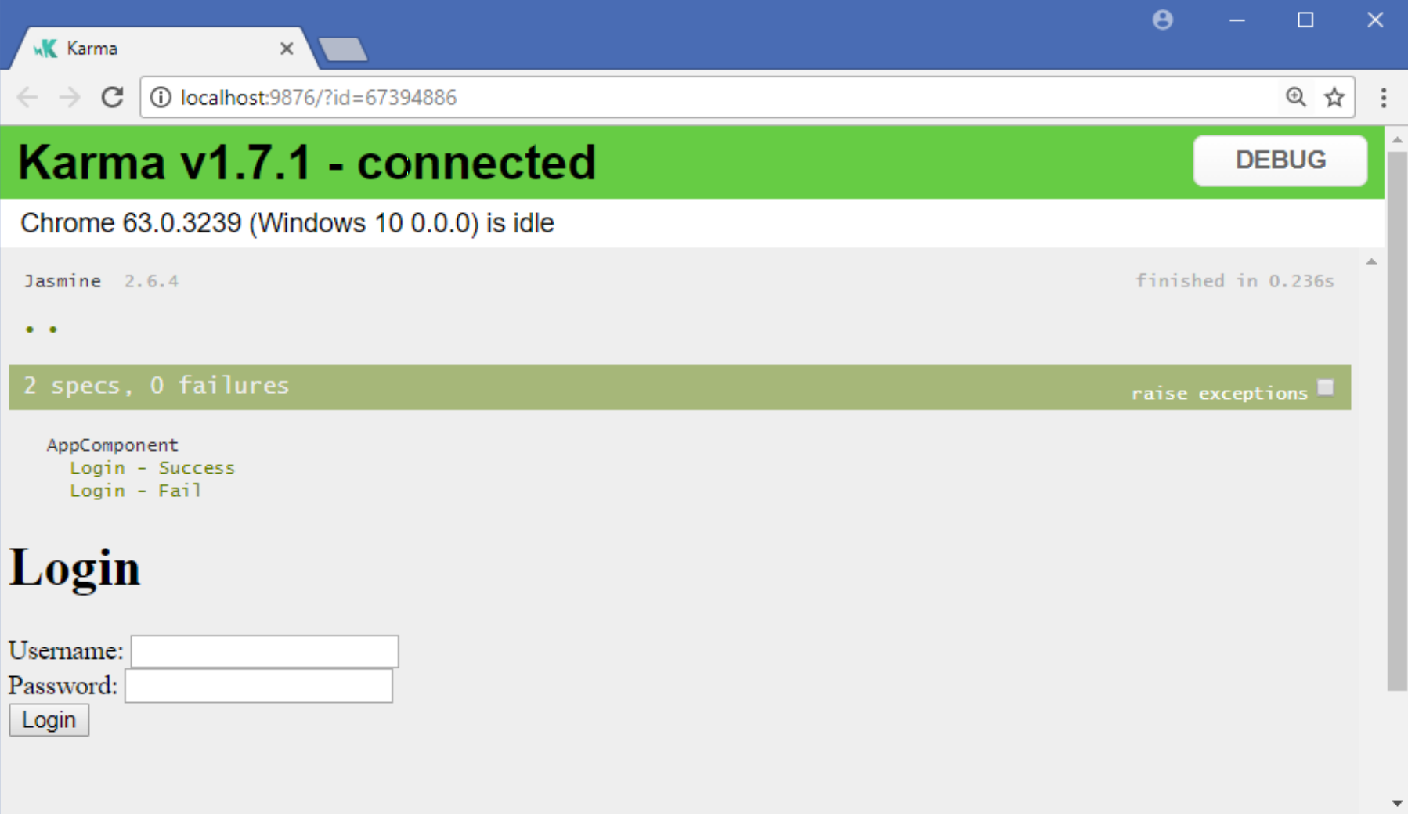
It automatically opens the Chrome browser at the following URL:
http://localhost:9876?id=57394886

